Slide 1

Washington D.C. crime analysis
Predicting Crime Rates Using Temporal Patterns and Environmental Conditions
David Warren
Pornpawee Khonchocho
Suhash Reddy Immareddy
Jake Patrick Ebreo

Slide 2
Table of content
Introduction
Data Preparation and Exploration
Models and Analysis
Conclusion

Slide 3
Introduction
Problem:
Rates of criminal behavior are influenced by social, environment and economic factors and can fluctuate significantly
Motivation:
Provide a solution to help address crime by helping police and public services department to properly allocate their resources by providing them analysis of crime data
Objective:
Analyze patterns of reported criminal behavior in the city
Provide visualization and analysis of crime which are happening in different area
Create a reliable and predictive models to estimate to the number of crimes expected on a day based on the following.
Temporal Factors (season, day, date)
Environmental (temperature, precipitation, snowfall)
Economic (current unemployment rate and trends)

Slide 4
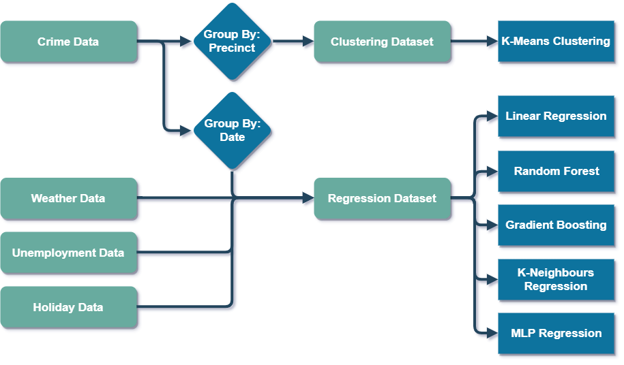
Data Sources and preparation
Datasets
Felony Crime Incidents – Washington D.C
Environmental Data - Washington Arboretum Weather Station 2010 - 2018
Unemployment Rates
School and Public Holidays, Paydays – Washington D.C. 2010 - 2018

Slide 5
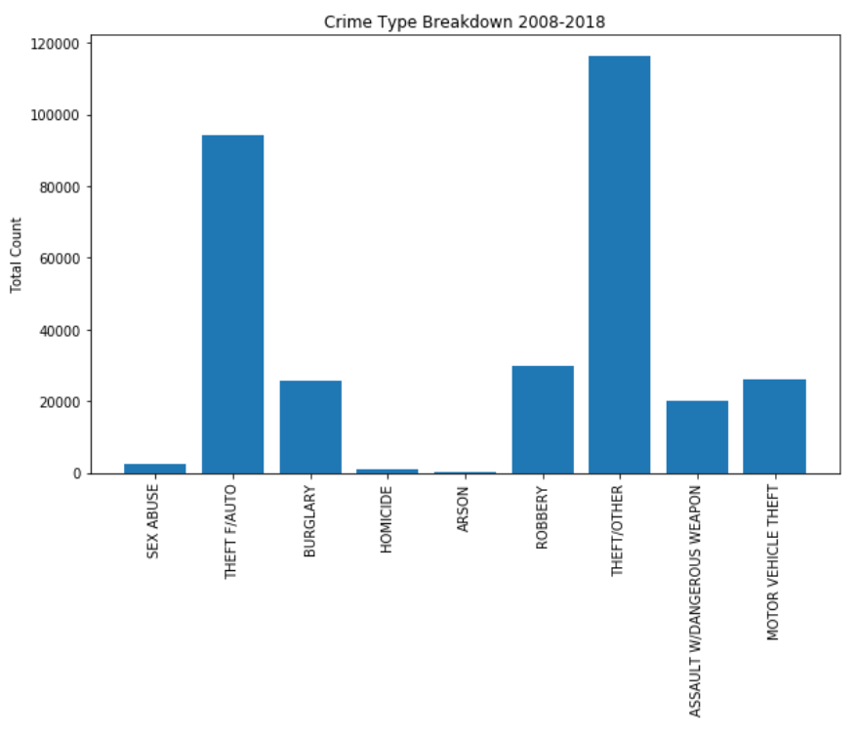
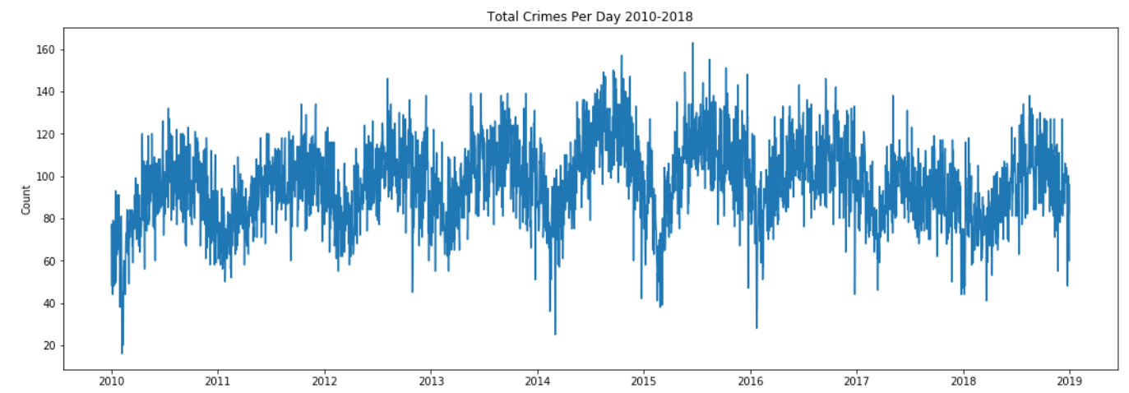
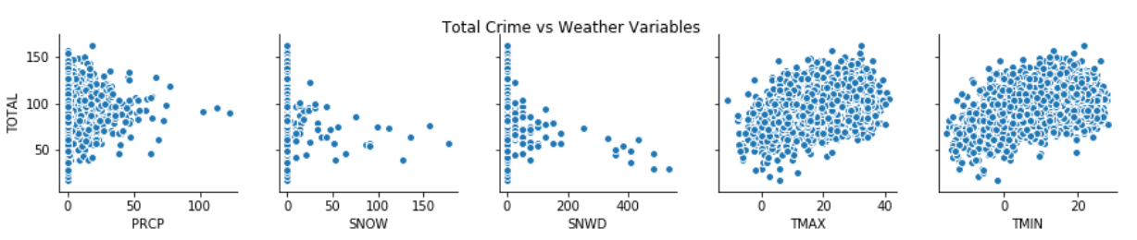
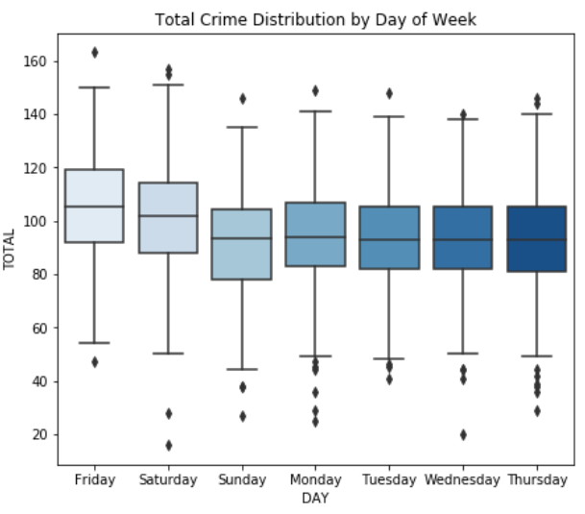
Exploratory And Descriptive Analysis
Clear Temporal Patterns – Weekly and Seasonal
Some Potential Correlation with Weather Data
Most Crimes are Theft (multiple types), Burglary & Robbery

Slide 6
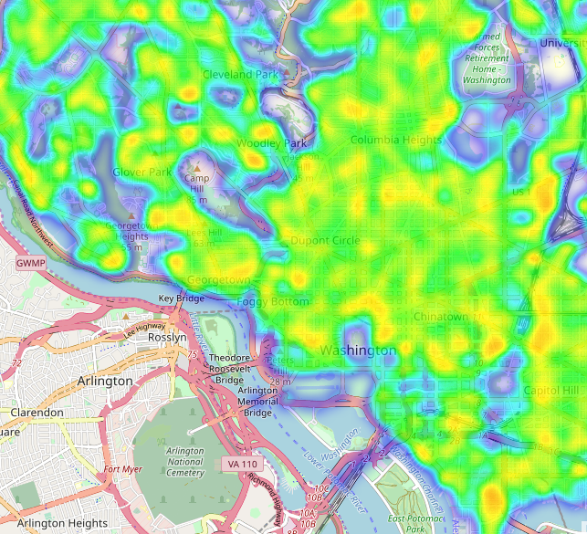
Crime heatmap
Total Crimes Reported:
Orange is high
Green is moderate
Blue is low
Identify problem areas and crime hotspots.
Allocate resources to minimize response time to these hotspots.

Slide 7
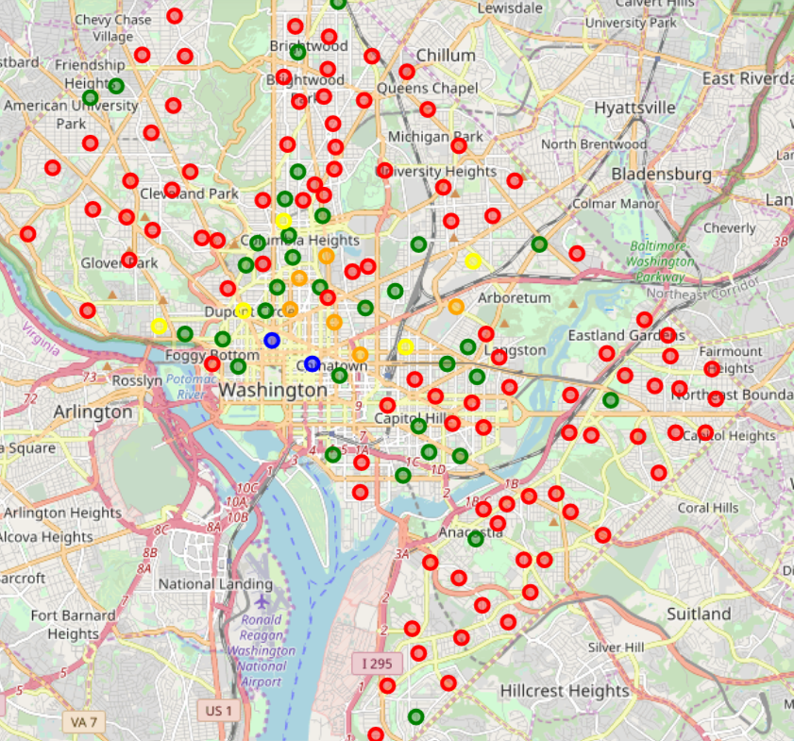
Precinct Cluster Analysis
Red - Medium homicide, low in all other categories.
Blue - High in assault, burglary, all types of theft, robbery and sex crime. Low in homicide.
Yellow - High in burglary, medium in all other areas.
Green - Medium burglary and homicide, low in all other categories.
Orange - High homicide, medium burglary, robbery, vehicle theft, sex crime.

Slide 8
Predictive Models and Analysis
Target Variable: Total Crime in Washington D.C. (Daily)
Predictors:
Calendar Features (Day of week, Month, Public Holidays etc.)
Weather Data (Temperature min/max, Rain, Snowfall, Wind)
Unemployment Rate
Train-Test Split:
80% Training
20% Testing
5 Regression Methods – All from sklearn Python packages.
Linear Regression
K-Neighbors Regression
Random Forest Regression
Gradient Boosting Regression
Multi-Layer Perceptron Regression

Slide 9
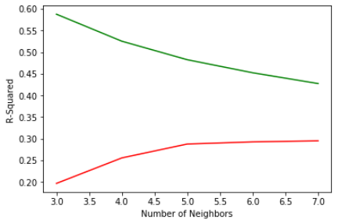
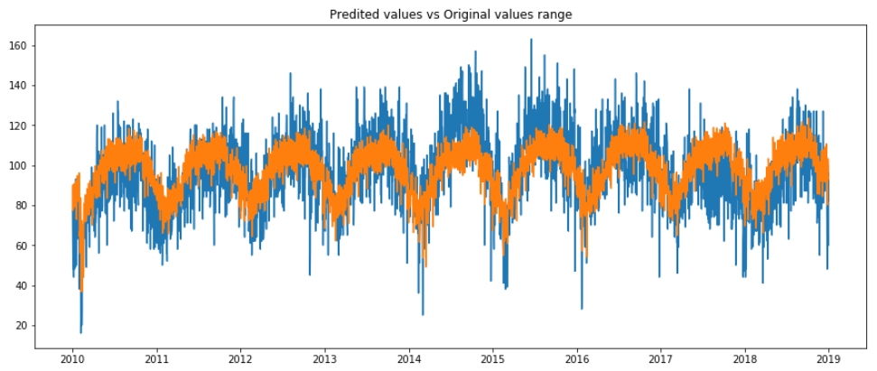
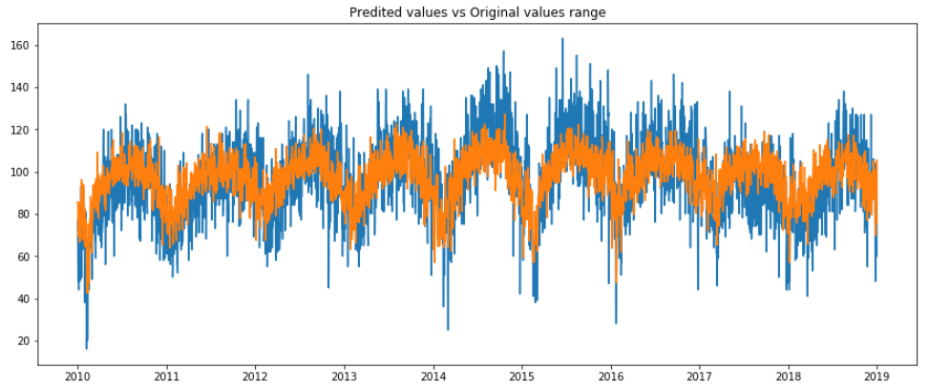
1. Linear Regression
2. K-Neighbors Regression
All predictors used.
No parameters tuned.
Parameters Tuned:
n_neighbors: [3 – 7]

Slide 10
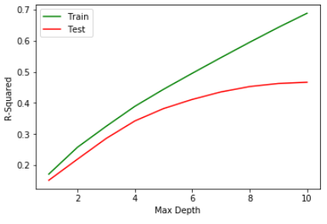
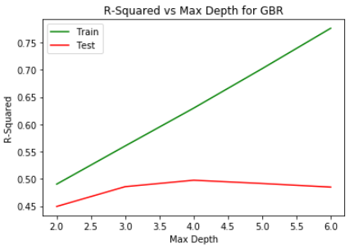
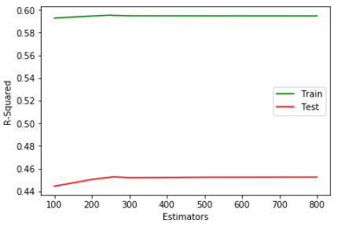
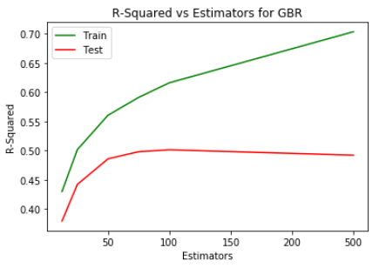
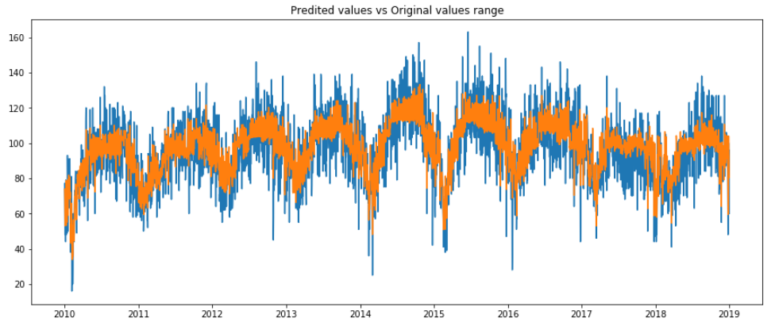
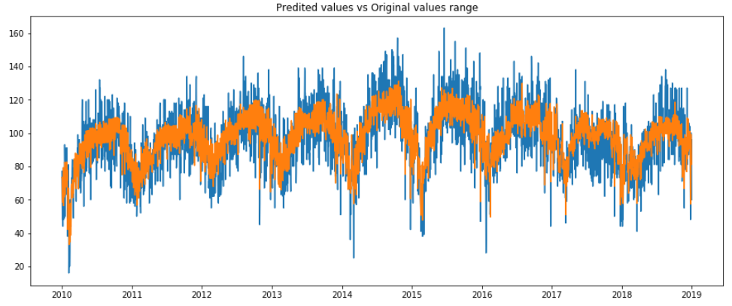
3. Random Forest Regression
4. Gradient Boosting Regression
Parameters Tuned:
max_depth: [1 – 10]
n_estimators: [10 – 800]
Parameters Tuned :
max_depth: [2 – 6]
n_estimators: [25 – 500]

Slide 11
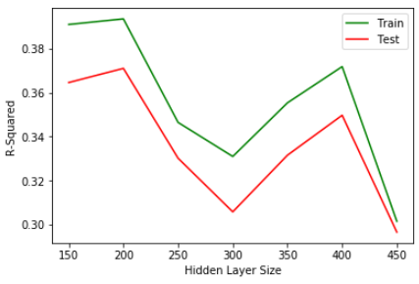
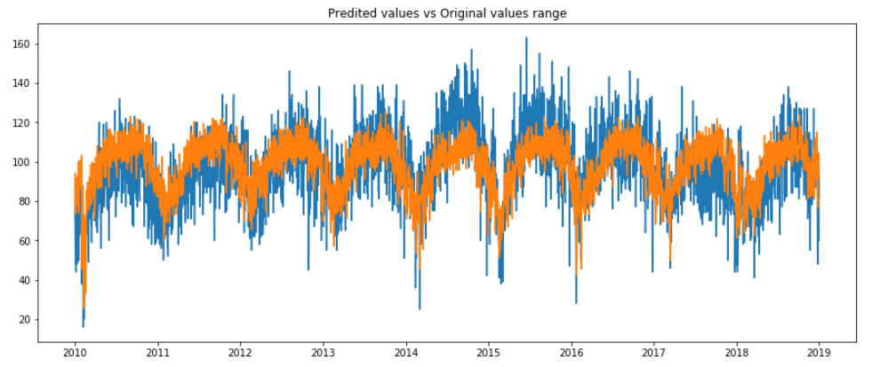
5. Multi-Layer Perceptron Regression
Parameters Chosen Based on Performance
Parameters Tuned:
max_iter: [200 – 450]
layer_sizes: [150 – 450]
Linear Regression: N/A
K-Neighbors:
Number of Neighbors: 5
Random Forest :
Number of Estimators: 257
Maximum Depth: 8
Gradient Boosting:
Number of Estimators: 100
Maximum Depth: 4
MLP Regression:
Hidden Layer Size: 200
Maximum Iterations: 350

Slide 12
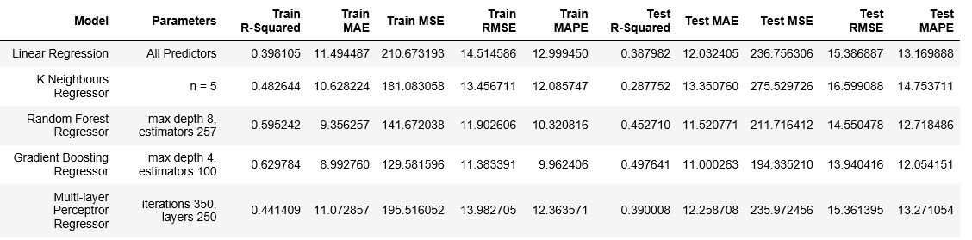
Comparison table of the models

Slide 13
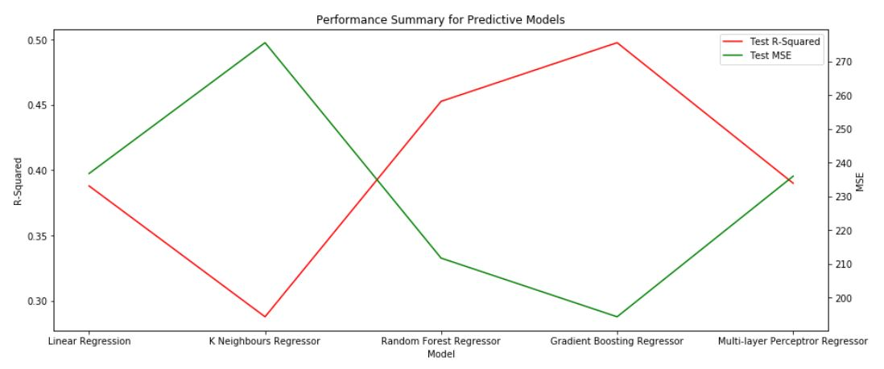
Comparison graph of the models

Slide 14
Conclusion
Descriptive analysis provides valuable insights into the distribution of crime throughout the city by identifying localized hotspots and identifying commonalities between precincts.
Predictive modelling gives law enforcement agencies useful estimates of how much crime to expect on a given day so that they can better provision resources. Random forest and the Gradient Boosting Models provide the best performance at the 0.45271 and 0.497641 R-squared respectively.
Prediction accuracy is imperfect but useful given the unpredictable nature of crime and comparable to studies conducted in other major cities.

